Slide 1
MILAGRO
Mixing with Mexico
New York City 10/17

Slide 2
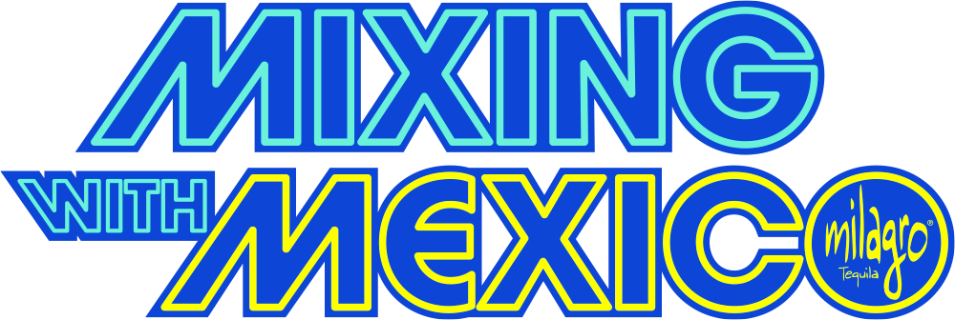
ACTIVATIONS
Recap
The MWM NYC activation at the Peacock Bar in New York City was bustling from the start to the end of the event. The guests enjoyed themselves, with most guests' dwell time being multiple hours and some staying to help clear up at the end. There were over 60 guests in attendance during the peak moments. The private tasting room was a big hit and extremely popular with guests. Attendees loved the music, with the 360 camera being very popular. Kaito created some delicious and unique drinks, with many bottles of Milagro being consumed throughout the night.
Splash
RSVP'd: 142
Checked In: 86
Unique Page Views: 265
Most Popular Job Total: Bartender 15
360 Camera
Videos Created: 80
Faces Per Photo: 1.69
Women: 43
Men: 55
Key Learnings
Location: It would be helpful to have more signage showing the bar's location, as it was hidden inside a restaurant.
Space: The space was an excellent fit for the amount of attendees that we had. We recommend at most 100 people in the bar at one time.
William Grant and Sons: 19 employees attended the event.
Charcuterie Board: We would not recommend this as a food option as only a few people tried it.

Slide 3
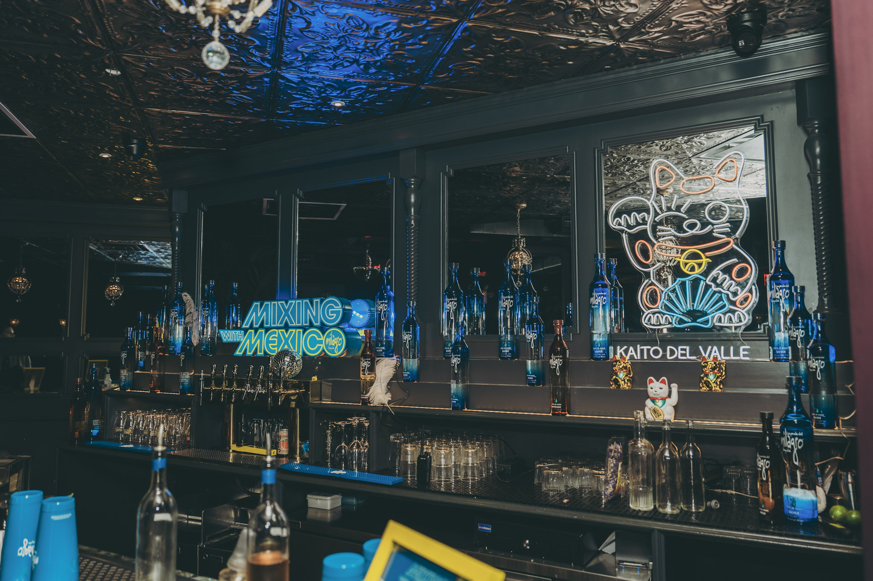
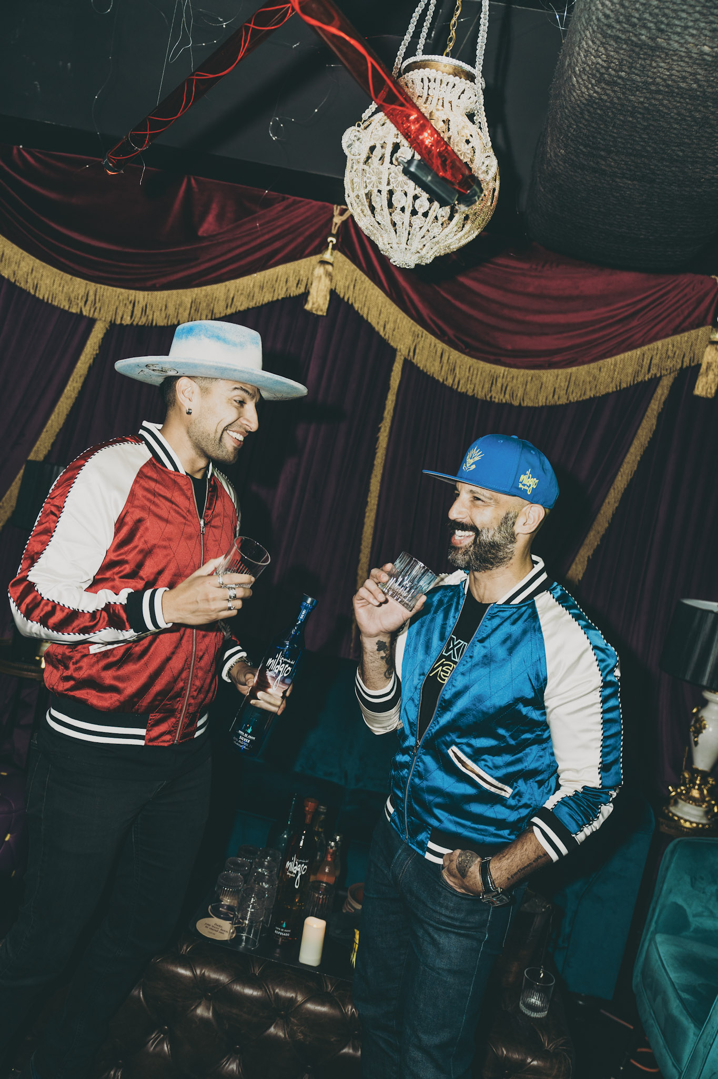
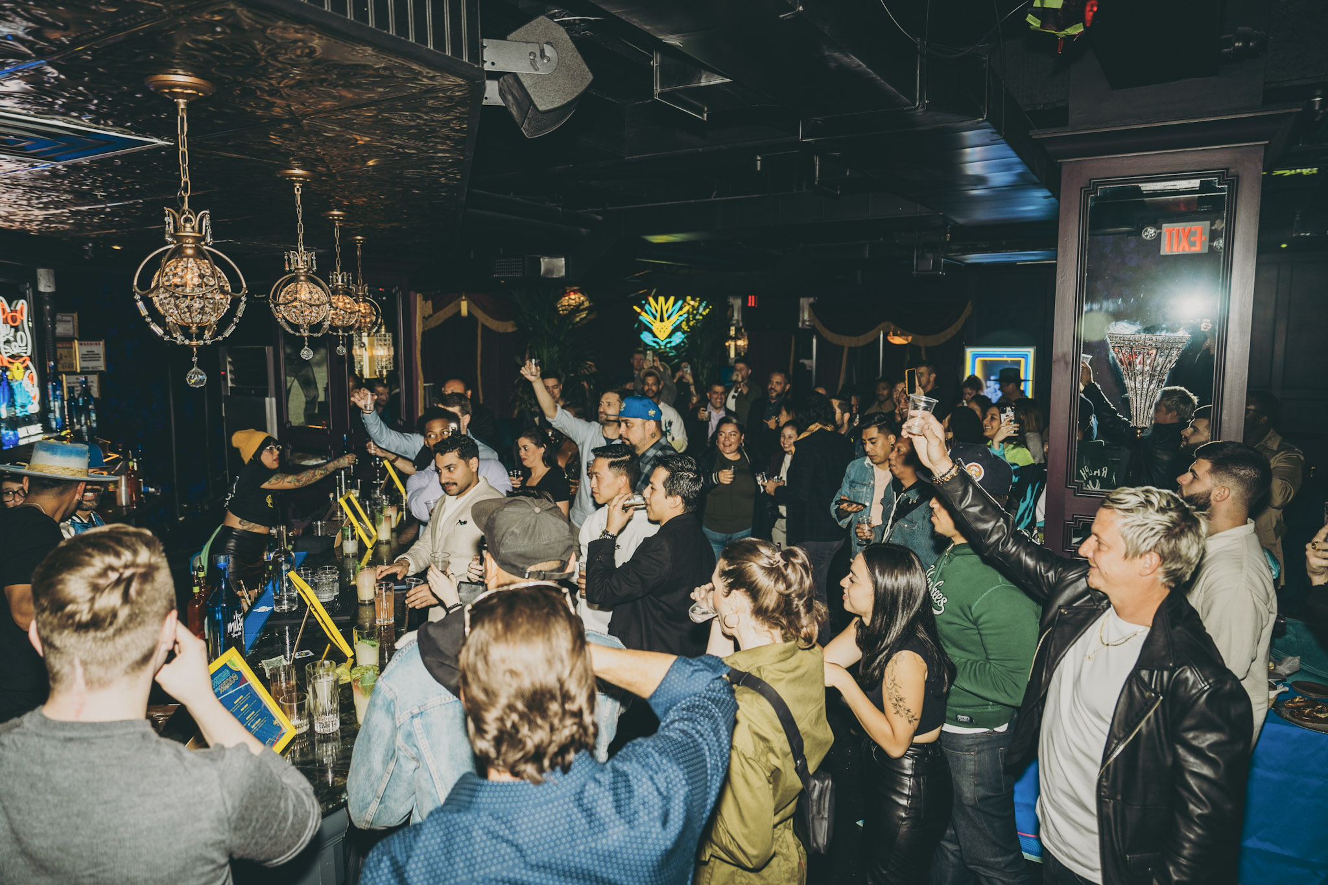
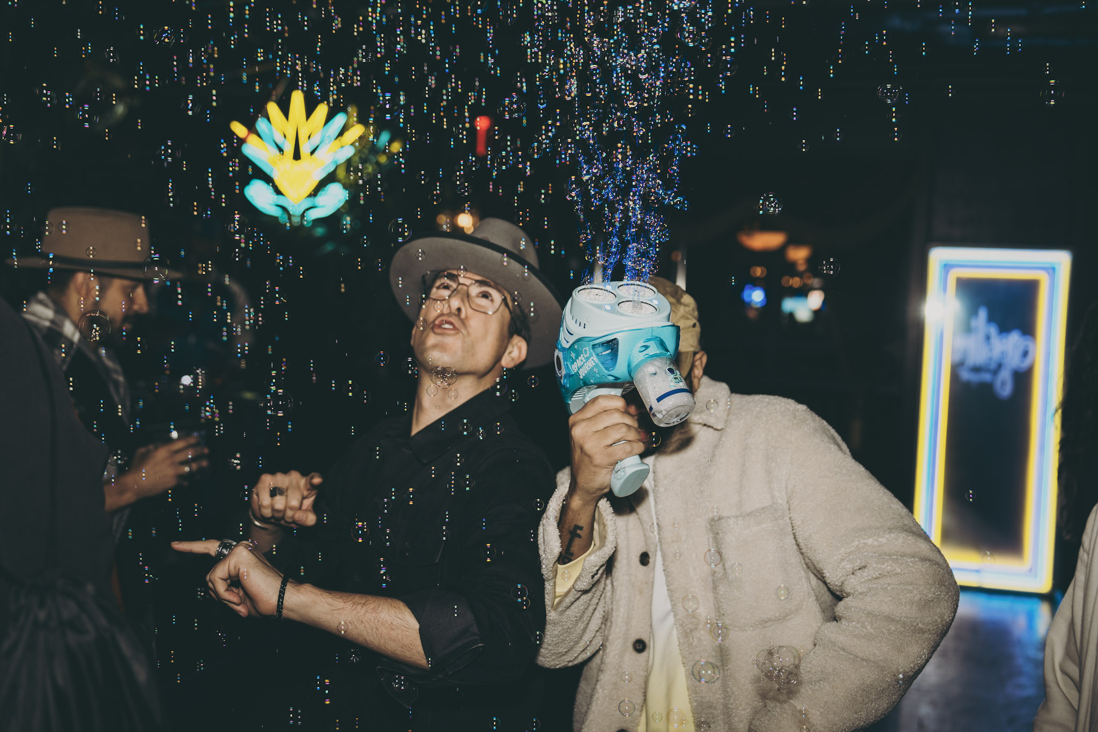
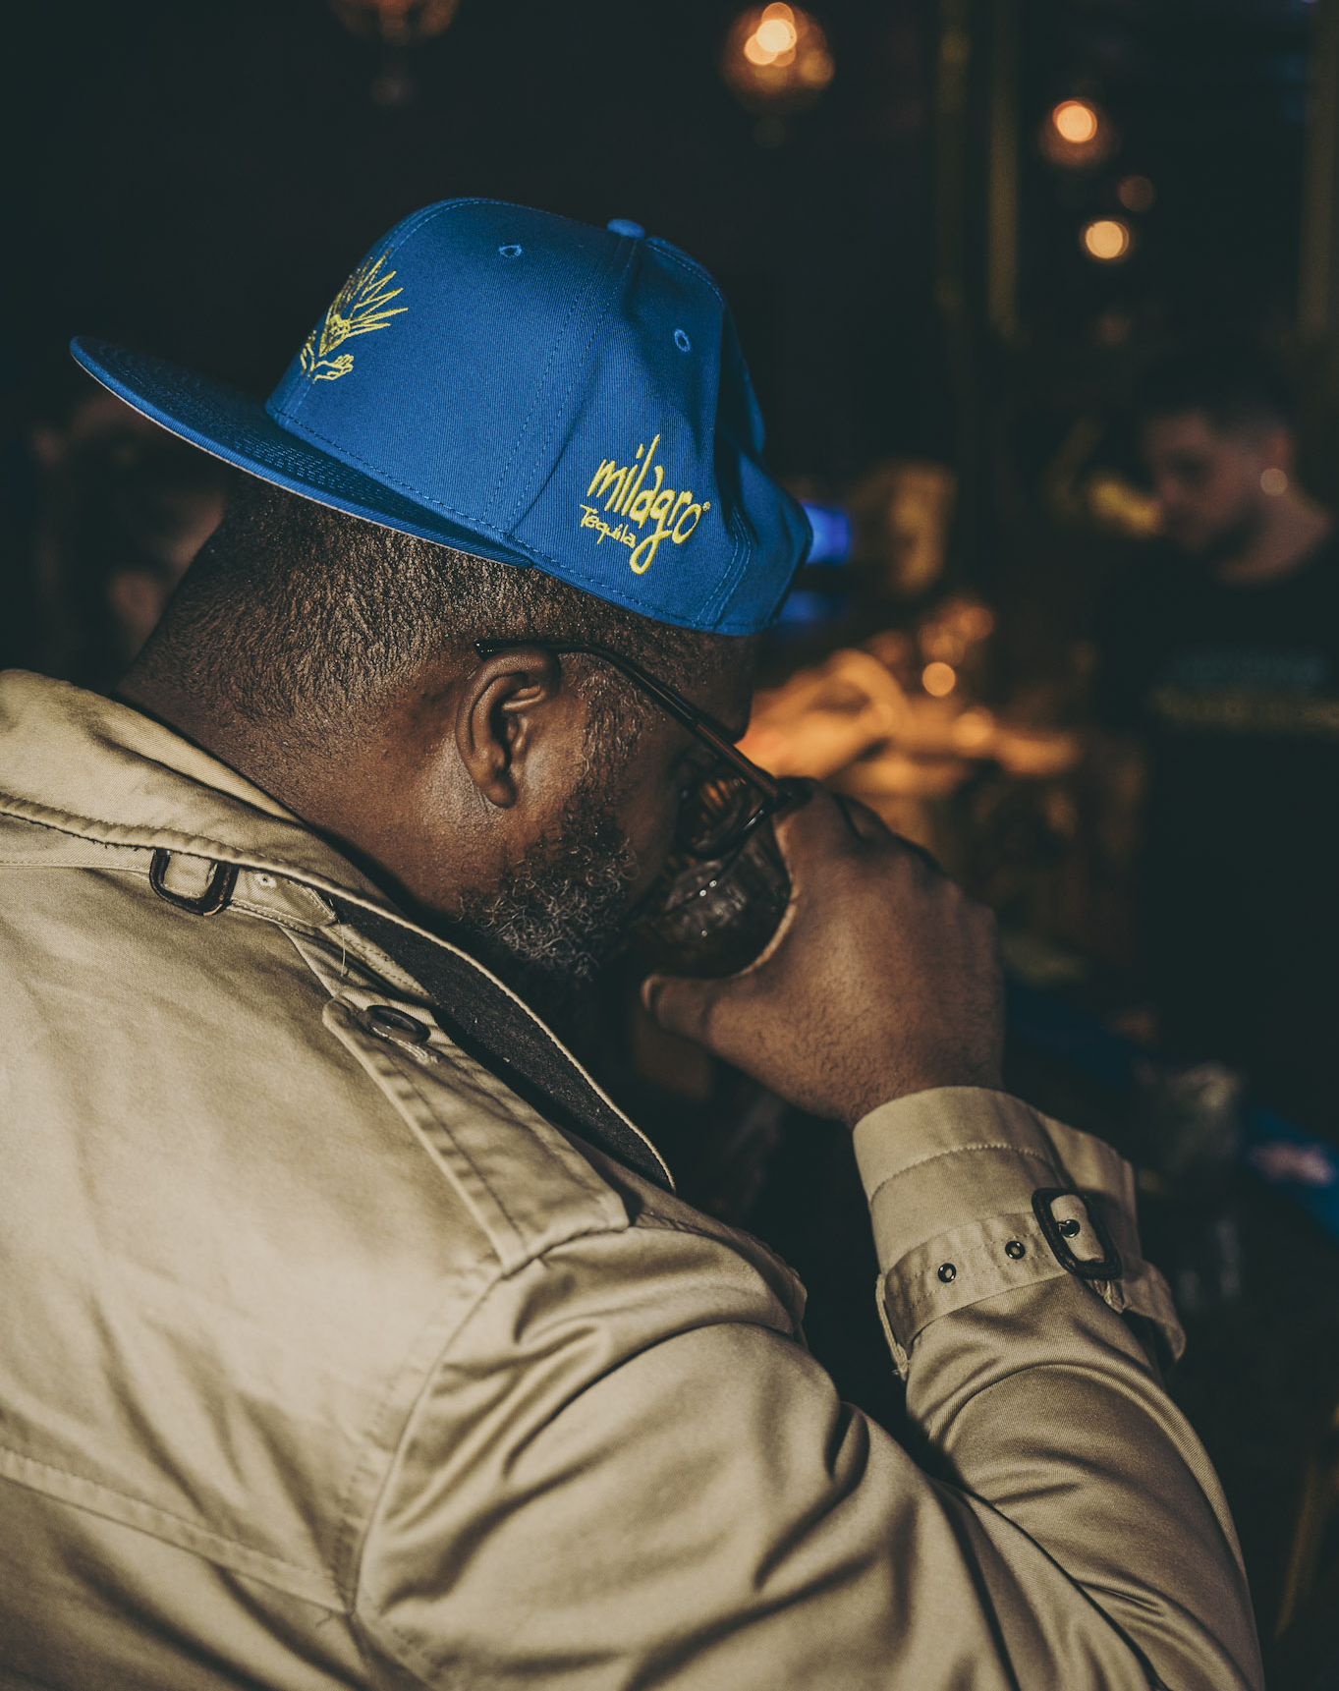
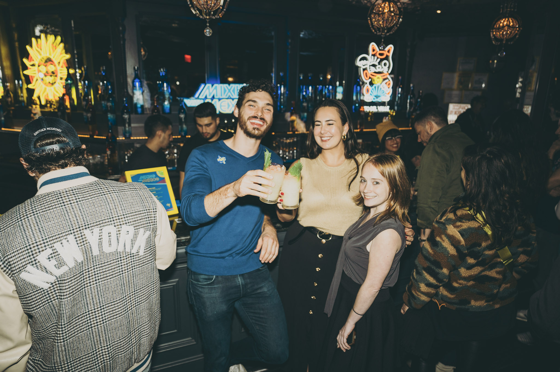

Slide 4
THANK YOU

